Slide 1
Non-determinism
blind monkey

Slide 2

Symbol
It represents the empty symbol.
If used , one state moves to the next without consuming any symbol
q1
q2

Slide 3
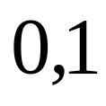

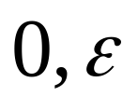
Automata example
q1
q2
q3
q3
q2
q4

Slide 4
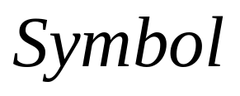
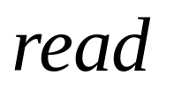

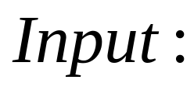
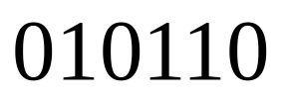
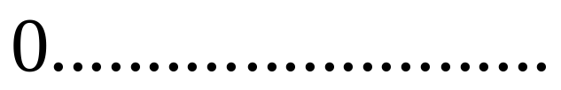
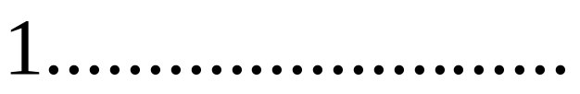
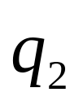

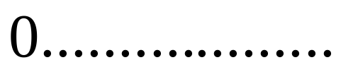
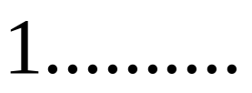
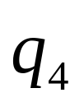
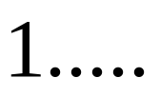
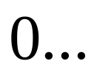

Slide 5
Acceptance of NFA
The nondeterministic machine accepts if at least one of the computation branches ends in an accept state.

Slide 6
Language recognized
Let A be a set of strings that contain either 101 or 11 as a substring.
E.G. 001010, 10111

Slide 7



Automata example
q2
q3
q1
q2
q3
q3

Slide 8
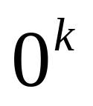
Language recognized
Accept all strings , where k is a multiple of 2 and 3.

Slide 9

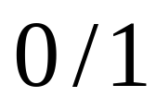
Problem: What language does it accept?
q2
q3
q2
q1
q2
q5

